Slide 1

Block Coding Developer
Session 39
HTML Styles - CSS

Slide 2

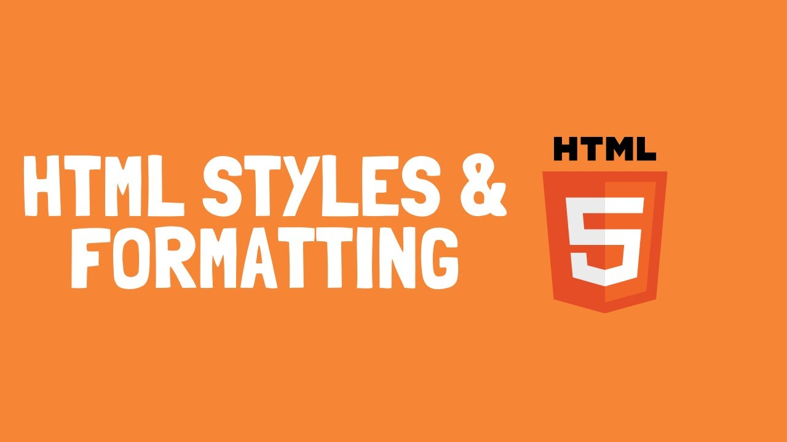
Recall…
What we have learnt in last session
What challenges you are facing?

Slide 3

HTML Styles - CSS
We will Learn today:
What is CSS?
Types of CSS
What is Inline CSS?
What is Internal CSS?
What is External CSS?
CSS text alignment

Slide 4

What is CSS?
CSS stands for Cascading Style Sheets
It is used to format the layout of a webpage
You can control the color, font, the size of text, and spacing between elements
CSS is independent of HTML and can be used with any XML-based mark-up language

Slide 5
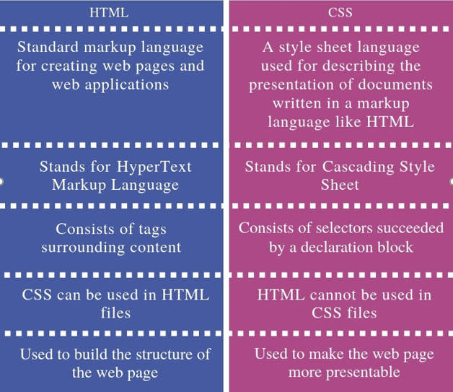
HTML vs CSS

Slide 6
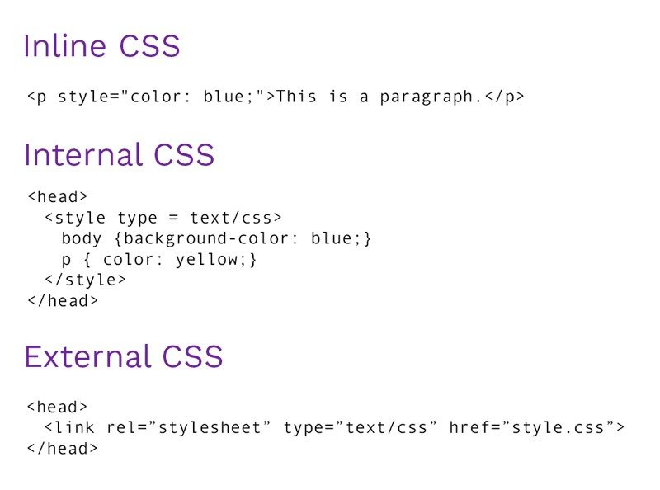
Inserting CSS…
There are three ways to insert CSS:
Inline CSS
Internal CSS
External CSS

Slide 7
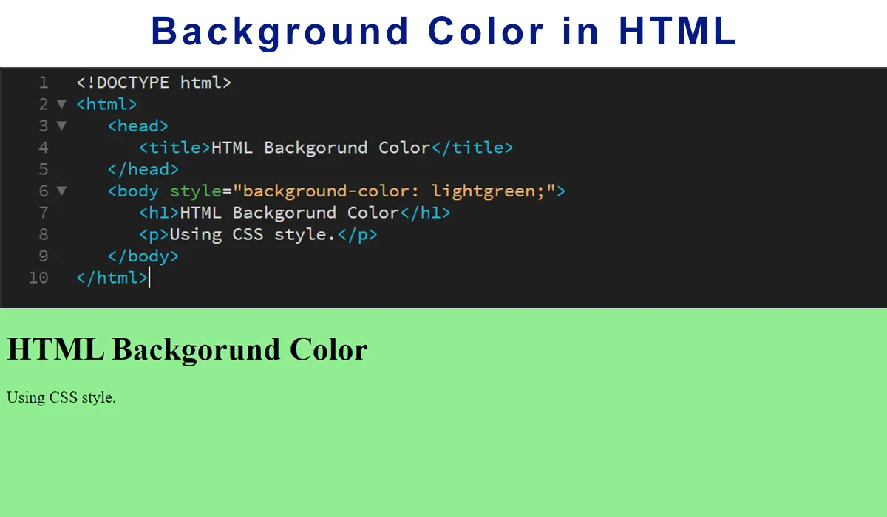
Inline CSS…
An inline CSS is used to apply a unique style to a single HTML element
An inline CSS uses the style attribute of an HTML element
An inline style loses many of the advantages of a style sheet (by mixing content with presentation). Use this method carefully

Slide 8
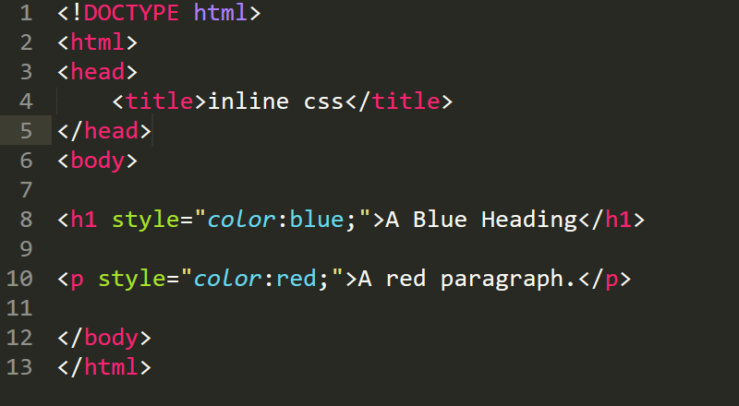
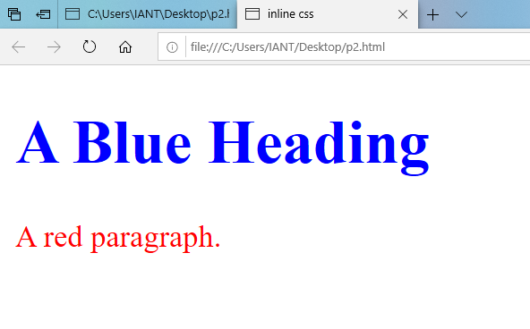
Example - Inline CSS…

Slide 9
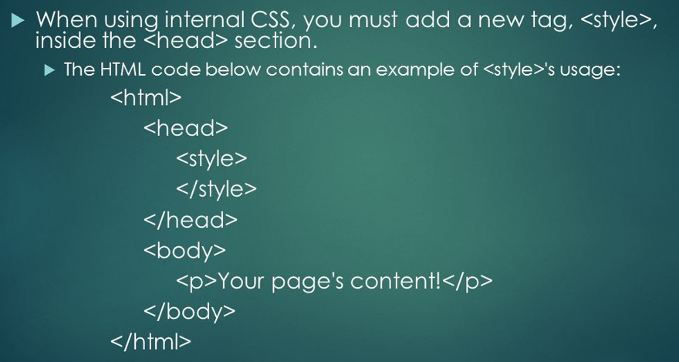
Internal CSS…
An internal CSS is used to define a style for a single HTML page
An internal css defined in the<head> section of an HTML page within a <style>element
An internal style sheet should be used when a single document

Slide 10
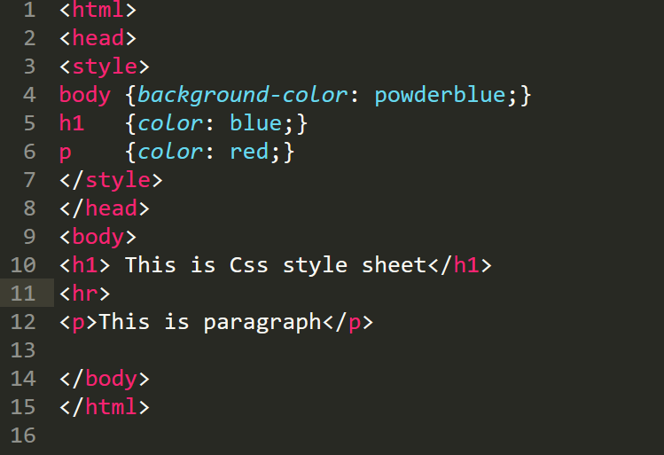
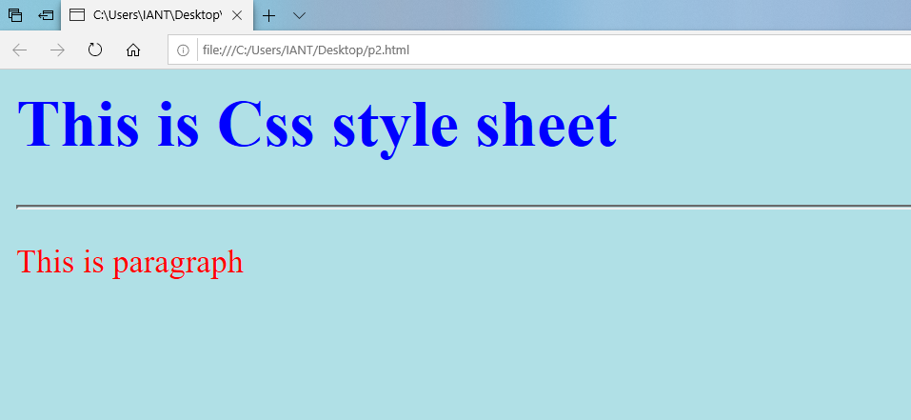
Example - Internal CSS…

Slide 11
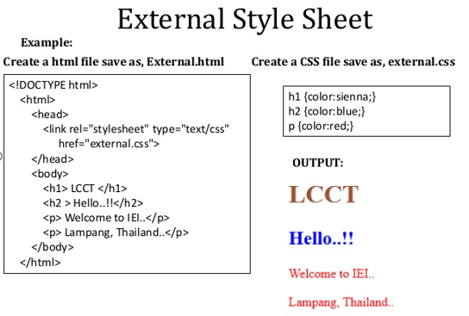
External CSS…
An external style sheet is used to define the style for many HTML pages
To use an external style sheet add a link to it in the <head> section of each HTML page

Slide 12
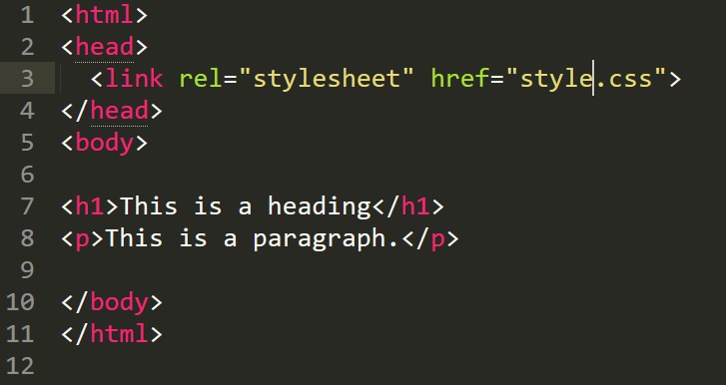
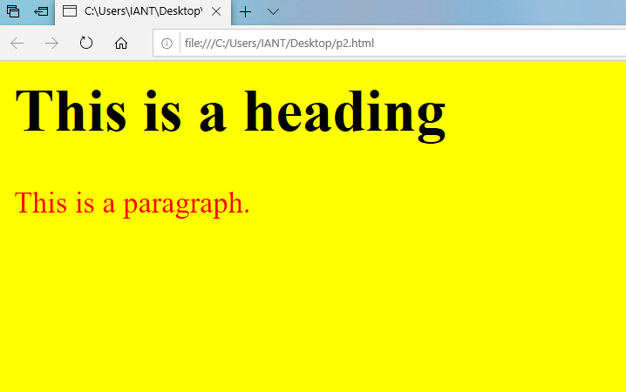
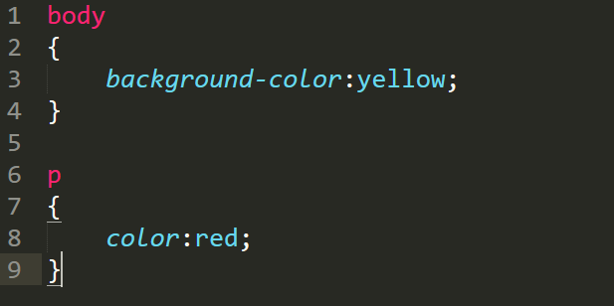
Example – External CSS…
Example1.html
OUTPUT
Style.css

Slide 13
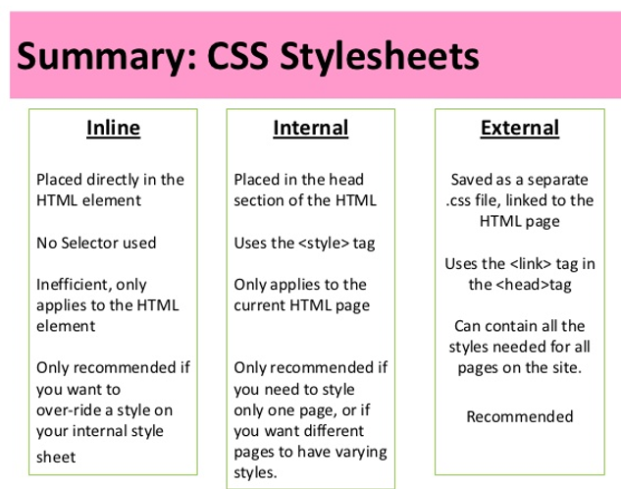
CSS Style Sheets - Summary…

Slide 14
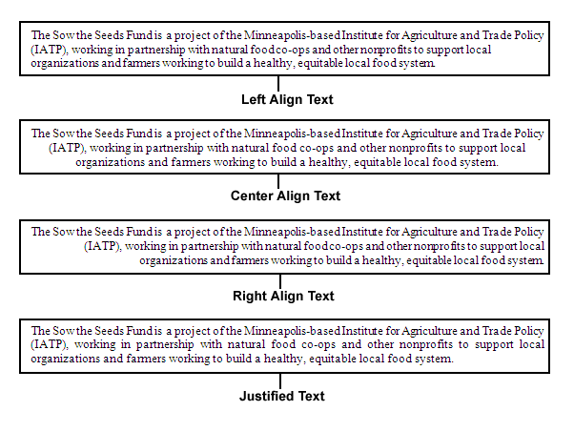
CSS Text Alignment…
The text-align property is used to set the horizontal alignment of a text
A text can be left or right aligned, cantered, or justified

Slide 15
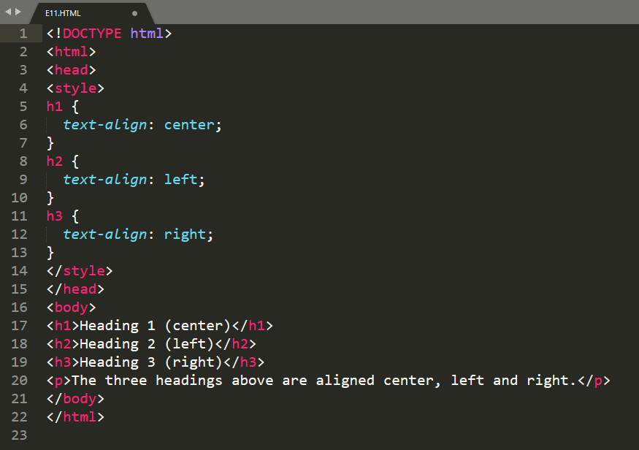
Example – CSS Text Alignment…

Slide 16
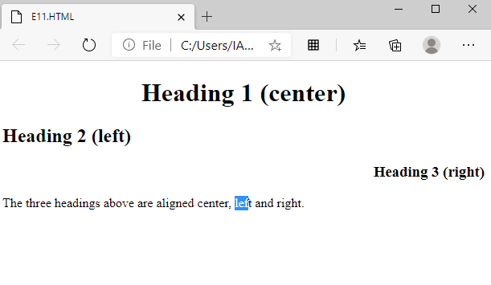
Output – CSS Text Alignment…

Slide 17
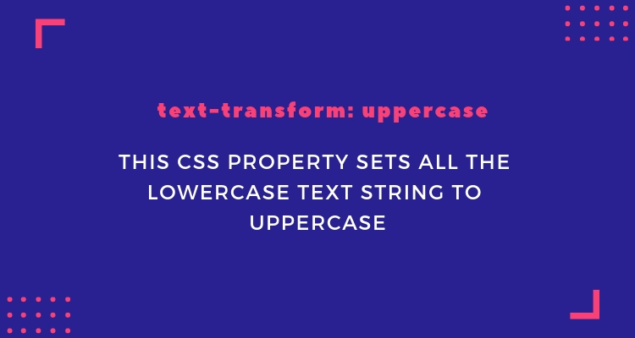
CSS Text Transformation…
The text-transform property is used to specify uppercase and lowercase letters in a text
It can be used to turn everything into uppercase or lowercase letters, or capitalize the first letter of each word

Slide 18
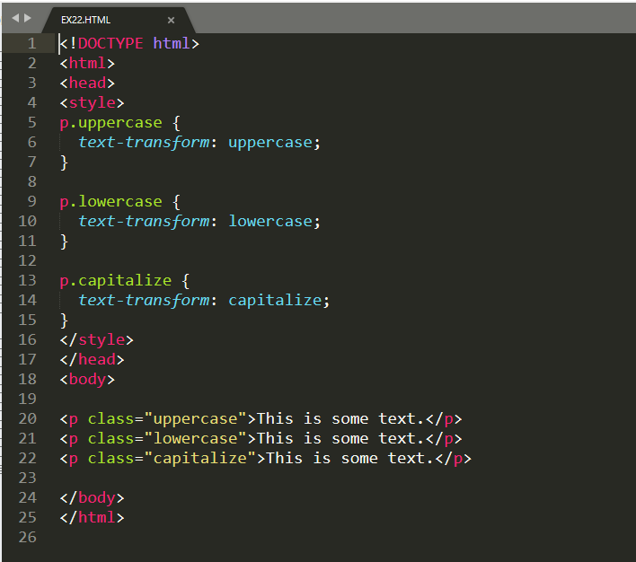
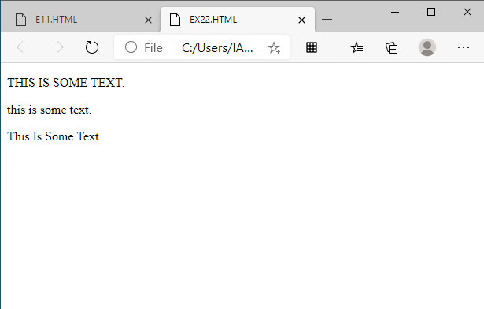
Example - CSS Text Transformation…
OUTPUT

Slide 19
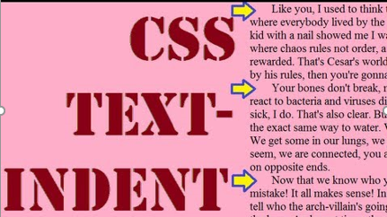
Text Indentation…
The text-indent property is used to specify the indentation of the first line in a text box
Negative values are allowed
CSS Syntax:
text-indent: length|initial|inherit;
Length defines a fixed indentation in px, pt, cm, em, etc.
Initial sets this property to its default value
Inherit, inherits this property from its parent element

Slide 20
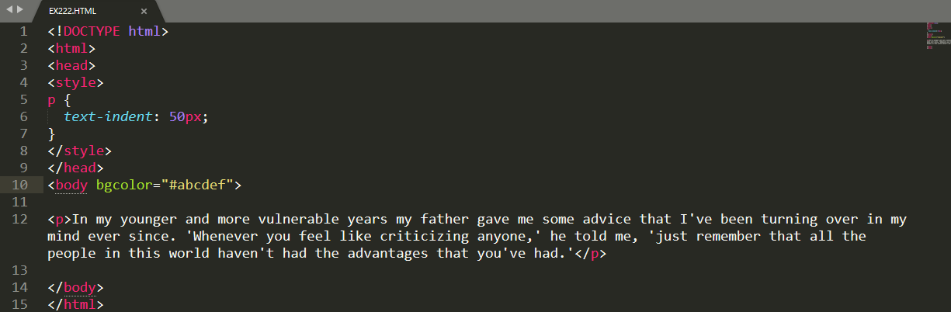
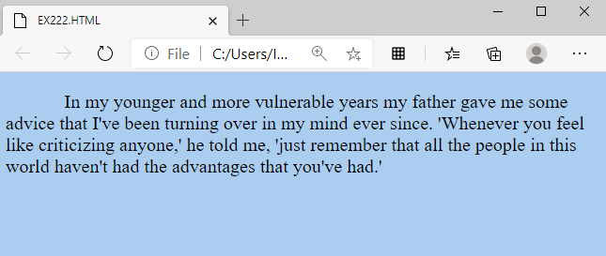
Example - Text Indentation…

Slide 21
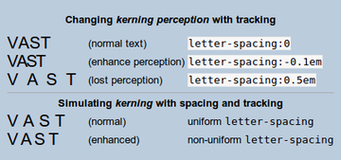
Letter Spacing…
The letter-spacing property is used to specify the space between the characters in a text
CSS Syntax:
letter-spacing: normal|length|initial|inherit;
Normal means No extra space between characters
Length defines an extra space between characters
Initial sets to its default value
Inherit, inherits this property from its parent element

Slide 22
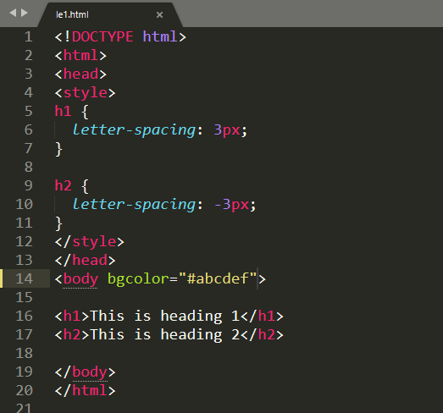
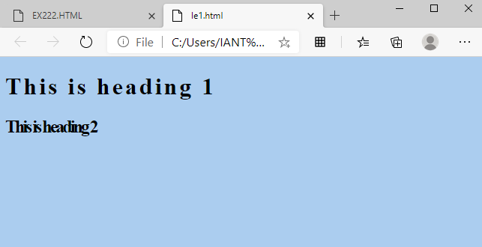
Example - Letter Spacing…

Slide 23
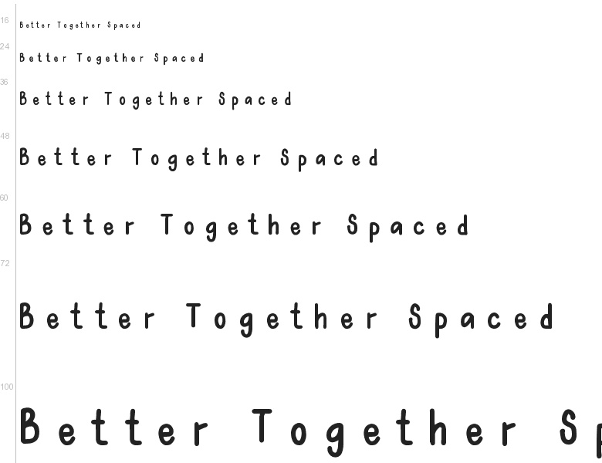
Word Spacing…
The word-spacing property increases or decreases the white space between words
CSS Syntax:
word-spacing: normal|length|initial|inherit;
Normal means normal space between words. Default 0.25em
Length defines an additional space between words
Initial sets to its default value
Inherit, inherits this property from its parent element

Slide 24
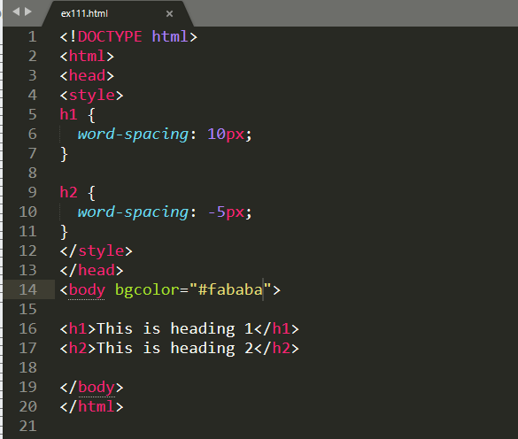
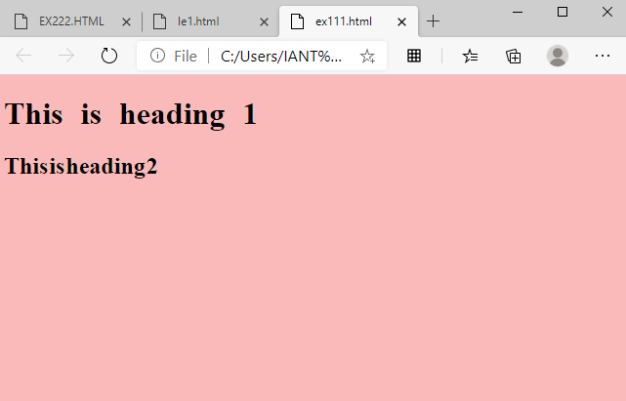
Example - Word Spacing…

Slide 25

Summary…
What is CSS?
Types of CSS
What is Inline CSS?
What is Internal CSS?
What is External CSS?
CSS text alignment

Slide 26
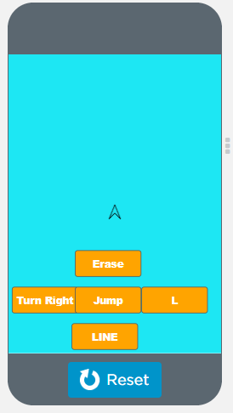
Next Session…
What is Turtle?
Turtle graphics element of the App Lab platform
Turtle Graphics Concept

